Slide 1
Tableau - MN Traffic Violation
File created on: 3/12/2021 9:50:43 PM

Slide 2
How would you describe the data set?
This is a data set of various citations across Minnesota given out in two years (2019 & 2020).
“Citation number” column provides the ticket number of each case and it is the primary key of the data set.
“Code” column represents the short description of ticket type.
“Vehicle Make” column tells us the model of a vehicle that has received the citation.
“Face Value” indicates the amount charged for the citation.
“Date” and “Time” columns provide insight in to when the citation was given.
“Vehicle Plate State” describes in which state the vehicle is registered.
“Address”, “Neighborhoods Description”, and “Wards” give the information about where the citation was given.
“Latitude” and “Longitude” provide the exact location where the violation occurred. These two columns could help to geographically visualize the location where the most and the least people tend to break the law.

Slide 3
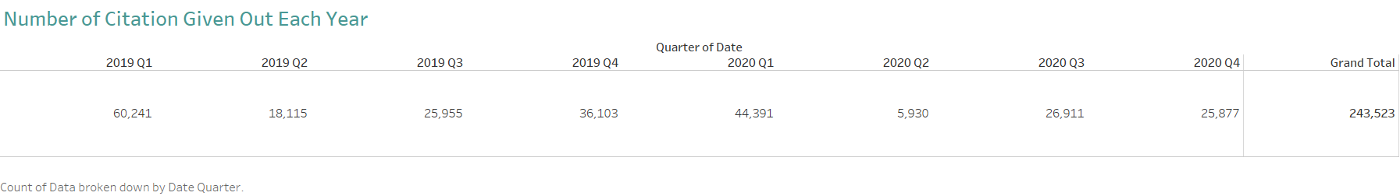
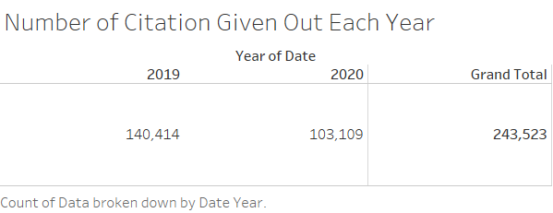
These are the total number of citations given out in 2019 and 2020, followed by the grand total. It has broken down in quarterly and yearly based. Year 2019 has approximately 37,000 more citations than year 2020.

Slide 4
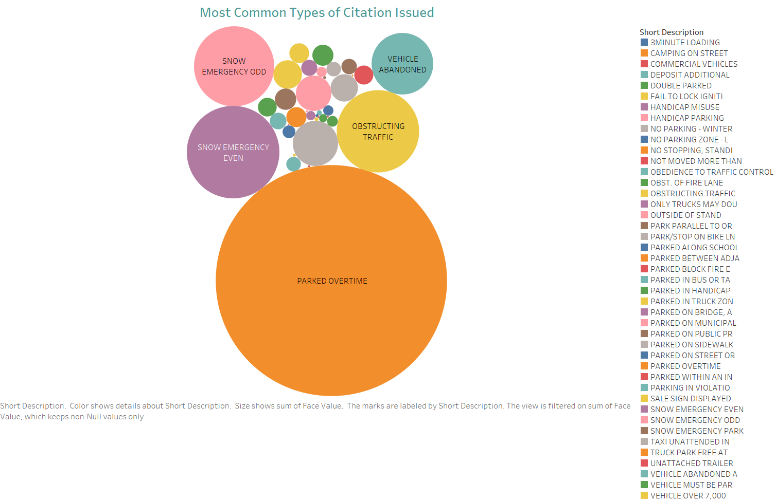
This bubble plot shows that the greatest number of citations are given in 2019 and 2020 for parking overtime.

Slide 5
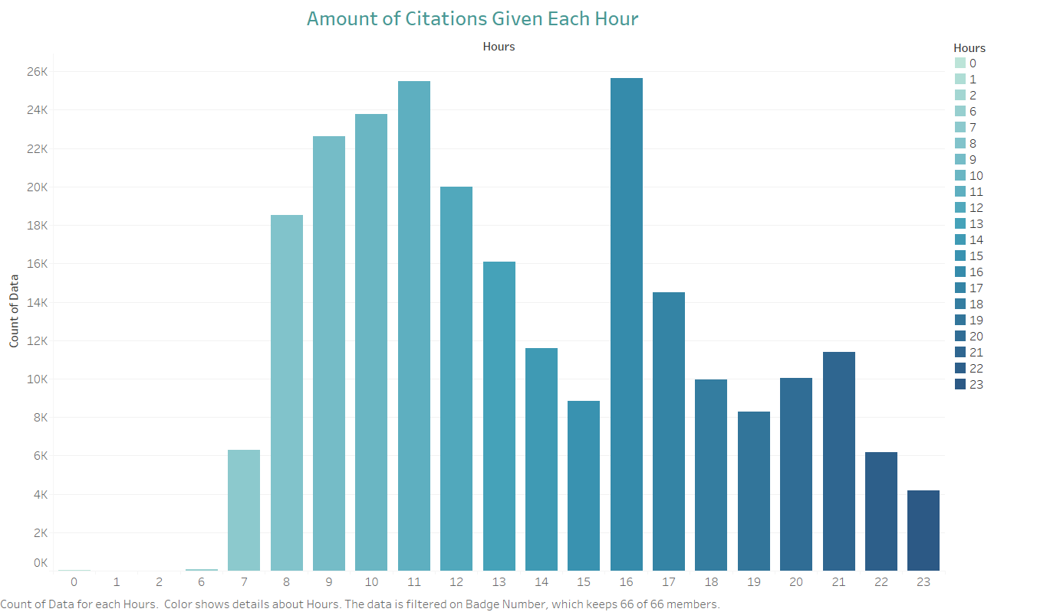
This graph shows the number of citations that are given in each hour for 2019 & 2020. The greatest number of citations are issued at 11:00 AM and 4:00 PM. Point to be noted that there are no citations issued between 3-5 AM.

Slide 6
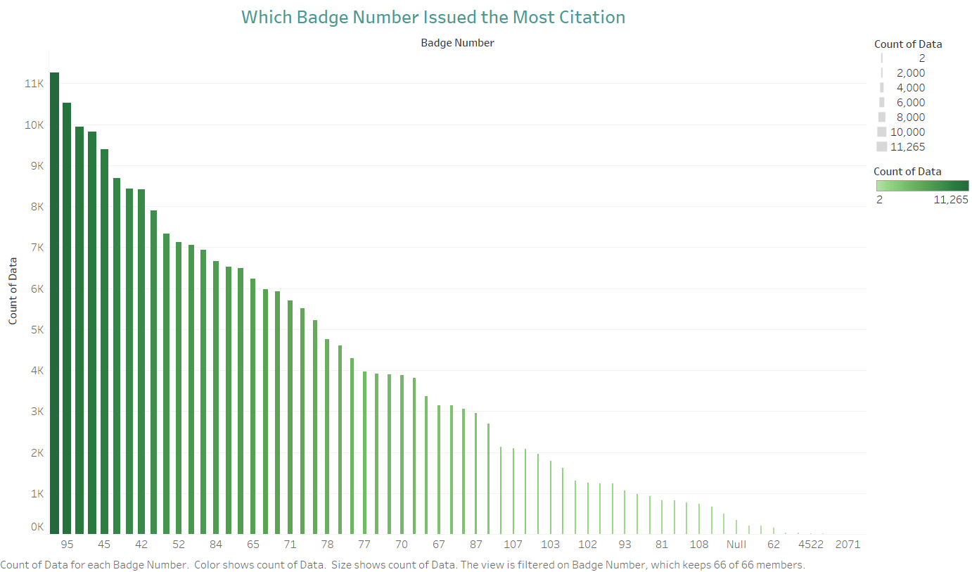
From this plot, we can see that badge number 73 and 95 issued the most citations out of anyone else in 2019 and 2020.

Slide 7
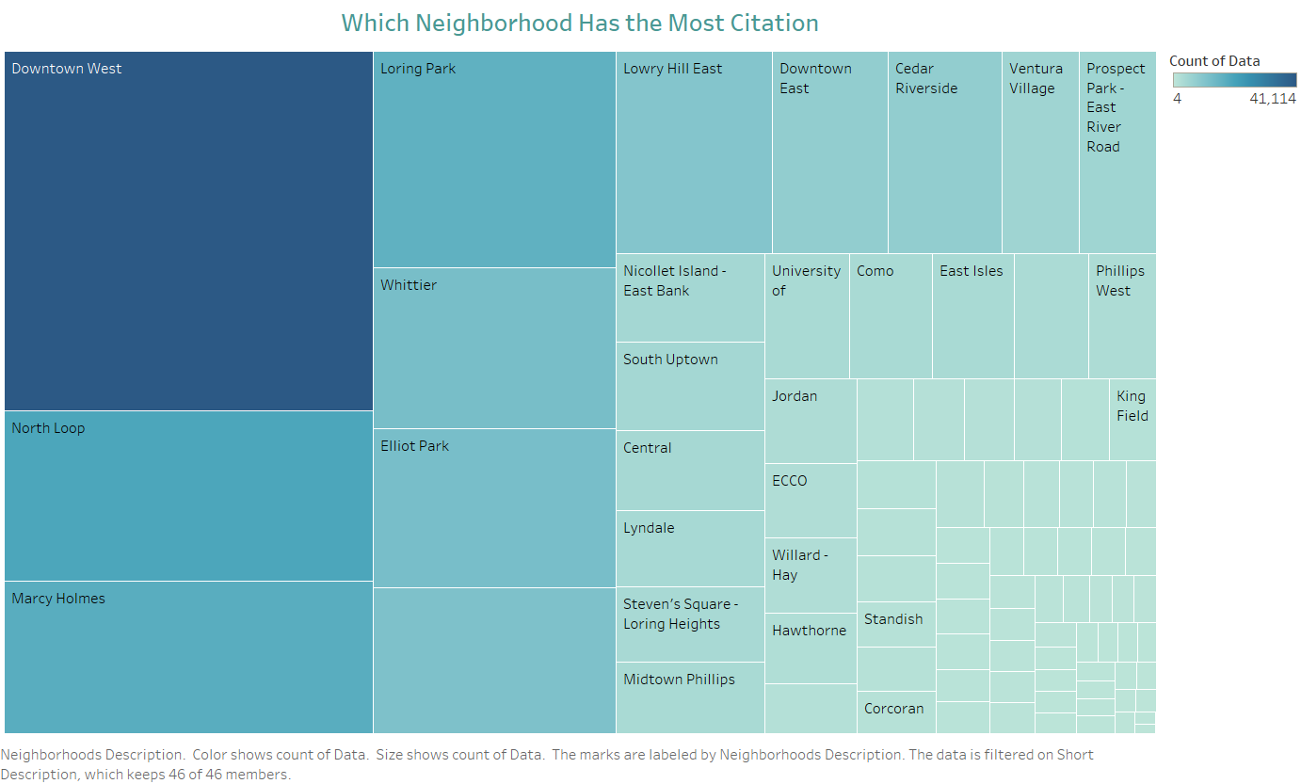
This plot shows that Downtown West neighborhood is the most common place to get a citation compare to the rest.

Slide 8
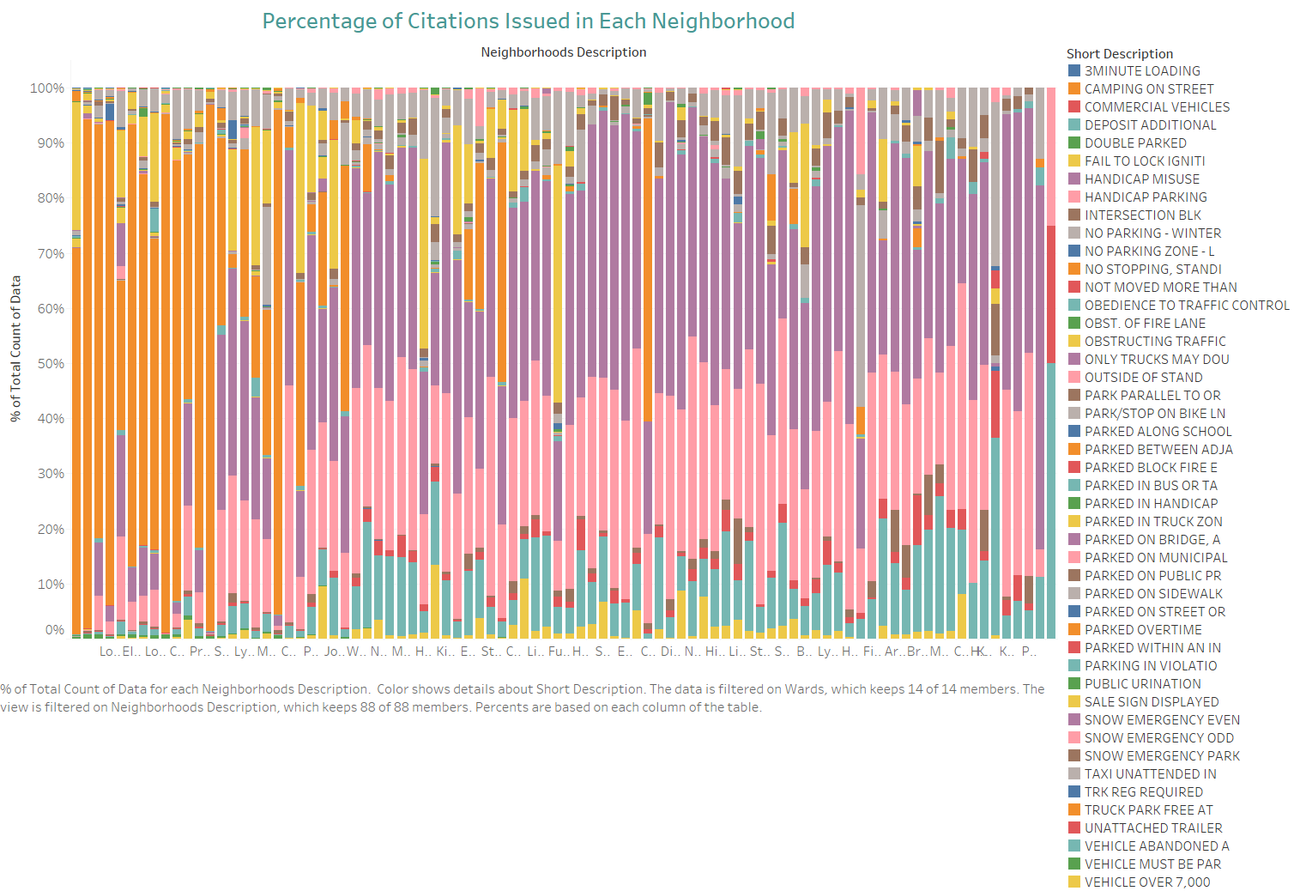

Slide 9
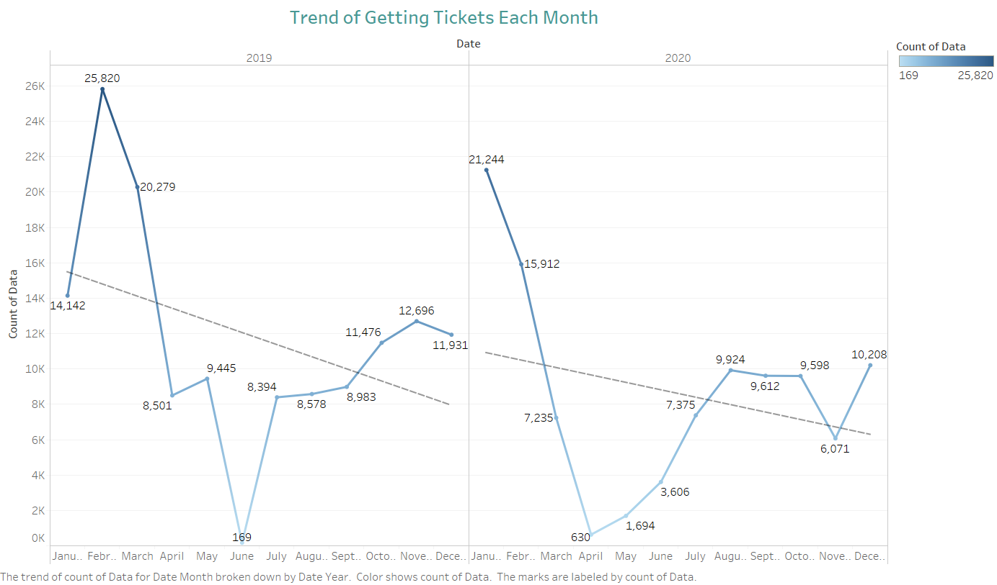

Slide 10
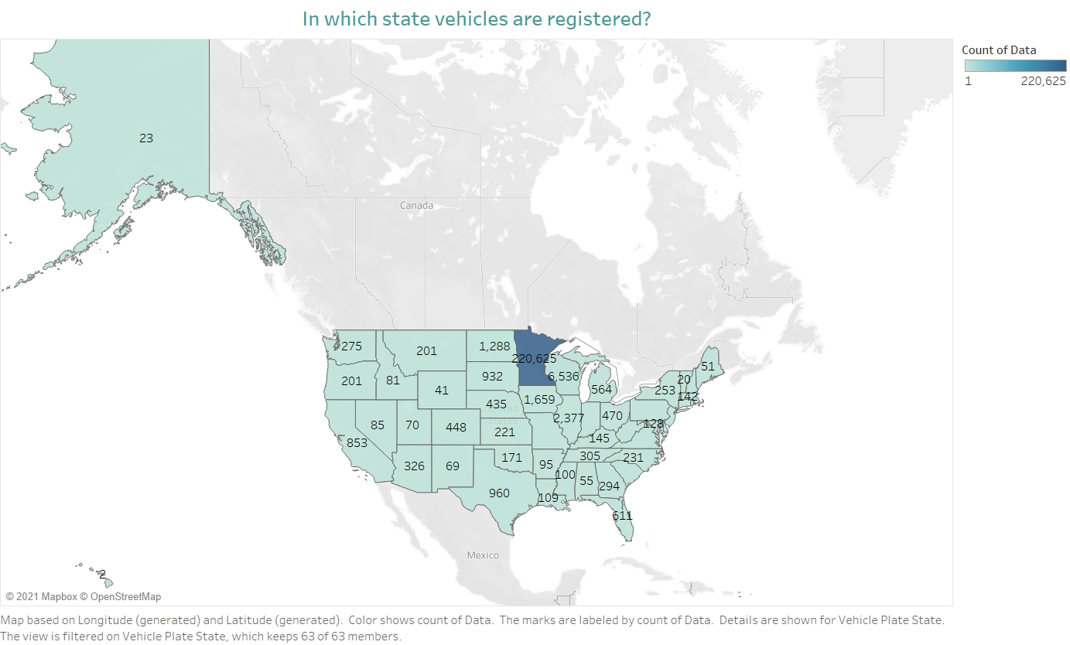

Slide 11
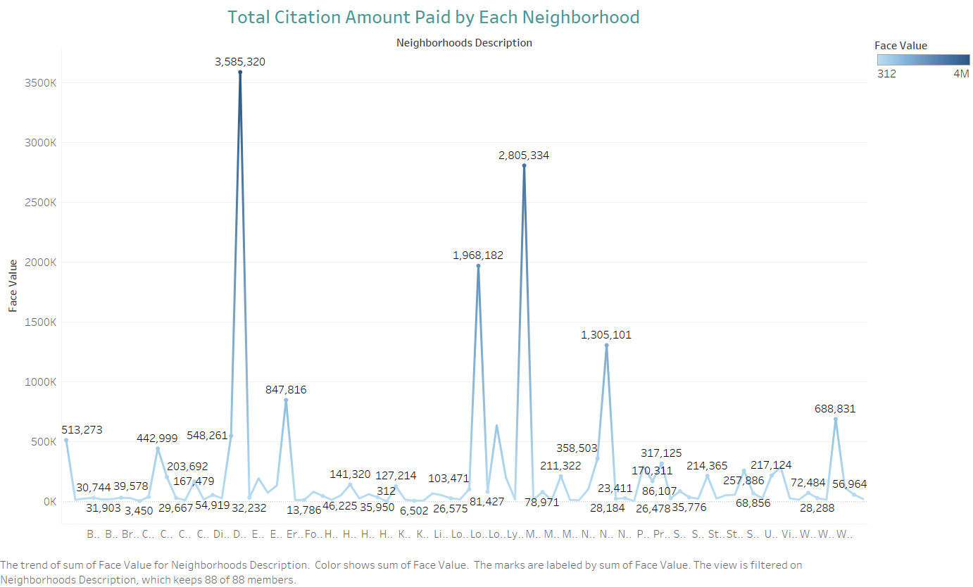

Slide 12
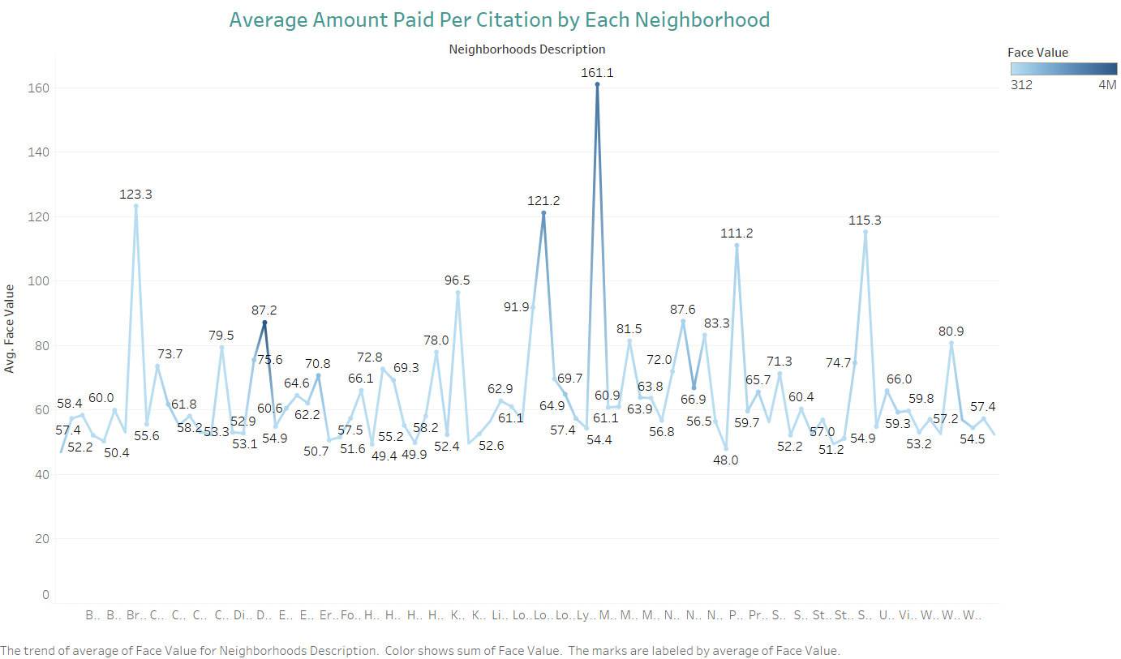

Slide 13
Given more time, what type of analysis would you undertake with the data?
Given more time, I would have created a geographical visualization that would help to see from which part of Minnesota are more likely to receive citation.
Gather more data to find out if there is any pattern for receiving citations in specific month of the year.
Find out the reason behind why the face value of penalty is different for same citation. For example, there are some charges for handicap misuse that are $578, and others are $1156.
Find what type of citations are the most common to in the neighborhoods with the highest number of citations.

Slide 14
Looking ahead to the next few years, what should the department expect and what recommendations would you make to leadership?
It would be more beneficial if the dataset had more information about more than 5 years. That would be helpful to figure out if there is any pattern in receiving the citations. For example, if each quarter share a significant characteristics in terms of receiving citation. This could be because of weather condition, vacation time, or lack of parking in certain areas.
The department can expect that out of all the citations, the five most common types would most likely be for parked overtime, snow emergency even, snow emergency odd, vehicle abandoned, obstructing traffic. Also, they can expect the most citations to be issued in the neighborhood of Downtown West, North Loop, Mercy Holmes, Loring Park, Whittier. Moreover, they can also expect people are more likely to violate the law during the office going and coming time.
My first recommendation for the leadership would be to have less police patrolling during the nighttime between the hours of 12-6 AM and more during the office going and coming time. As a recommendation to decrease the number of citations given in the neighborhoods that currently have the most, they should figure out which type of citations are being given and how to facilitate the solution. For example, most of the citations given in Downtown West are due to parking overtime. As a solution, the leader can implement a better system to help people track their parking status and increase the parking facilities.

